Slide 1
Lecture 09: Interaction and Faceting
DS 4200
Fall 2022
Prof. Ab Mosca (they/them)
Northeastern University
Slides and inspiration from Cody Dunne, Michelle Borkin, Dylan Cashman, Krzysztof Gajos, Hanspeter Pfister,
Miriah Meyer, Jonathan Schwabish, and David Sprague

Slide 2
Reminders / Notes
Ab is out of town for a conference next week
You will have a larger than usual pm assignment, knowing that you have class time to work on it
The pm will be due Friday at 11:59pm
If you would like to know your mid-semester grade you can ask at the end of class today or send me an email

Slide 3
Last Class
We:
Looked at the “Arrange” step of table visual encodings
Any Questions?

Slide 4
Today
Review Interaction
Review Faceting

Slide 5
Interaction
Notes:
Let’s start with interaction

Slide 6
Interaction
Benefits of Interaction
Enables visualization of large amounts of data
Amplifies user cognition (supports sensemaking)
Increases engagement (vis becomes personal to user)
Increases deep learning and learning transfer
Notes:
There are a lot of benefits to making visualizations interactive.
For example <read>
<next>

Slide 7
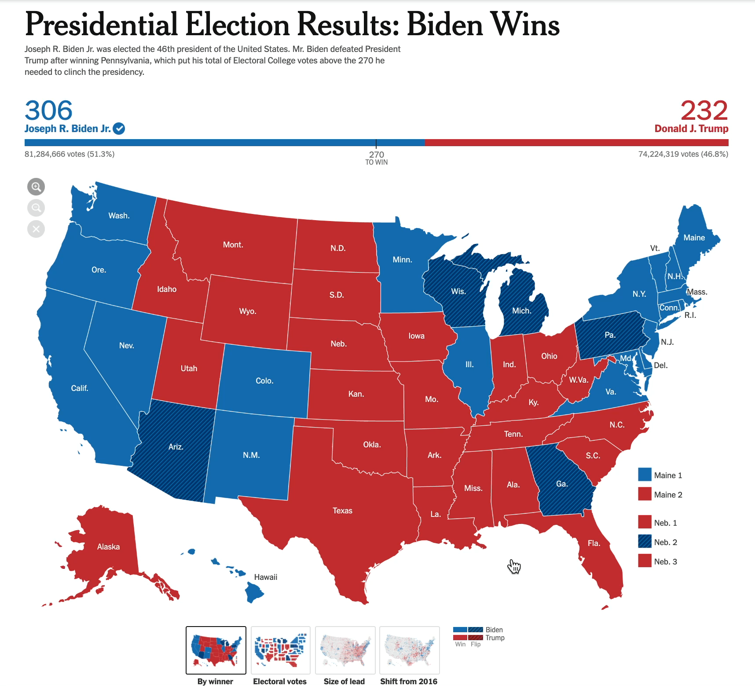
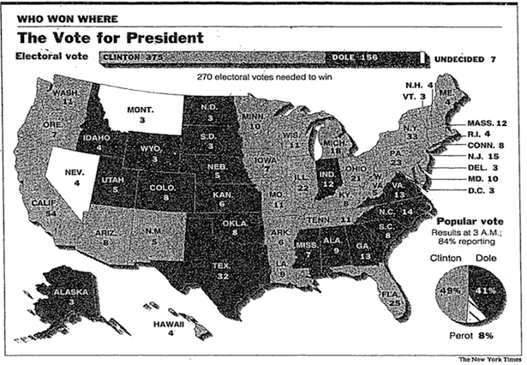
Interaction
1996 → 2020
https://www.theatlantic.com/technology/archive/2012/11/116-years-of-electoral-infographics-from-the-new-york-times/264692/
https://www.nytimes.com/interactive/2020/11/03/us/elections/results-president.html
Notes:
In other words, there’s a reason visualization have moved from the static back and white images like those shown on the left here, to colorful, interactive ones like the one shown on the right.
Adding interaction here achieves all of those benefits described in the last slide
It allows us to shown more data by hiding it and making it available on mouse over
And it enables the user to sort through, or make sense of, the data at their own pace and in their own way
<next>

Slide 8
Interaction
Caveats of Interaction
Requires human time and attention
Increase perceptual and exploration costs (van Wijk 2005)
Interaction costs (Lam 2008)
Multiple user studies find no increase in performance (Theis et al. 2016, Ragan et al. 2012, Mosca et al. 2021)
Notes:
However, despite those benefits, there are some downsides associated with interaction.
<read>
<next>

Slide 9

Interaction
Benefits
Costs
Notes:
So at the end of the day, as with most design decisions, when and how you add interaction to a visualization is a matter of striving to balance costs and benefits.
In other words, whether interaction is appropriate and helpful to a visualization is partially up to you as the designer to determine.
<next>

Slide 10
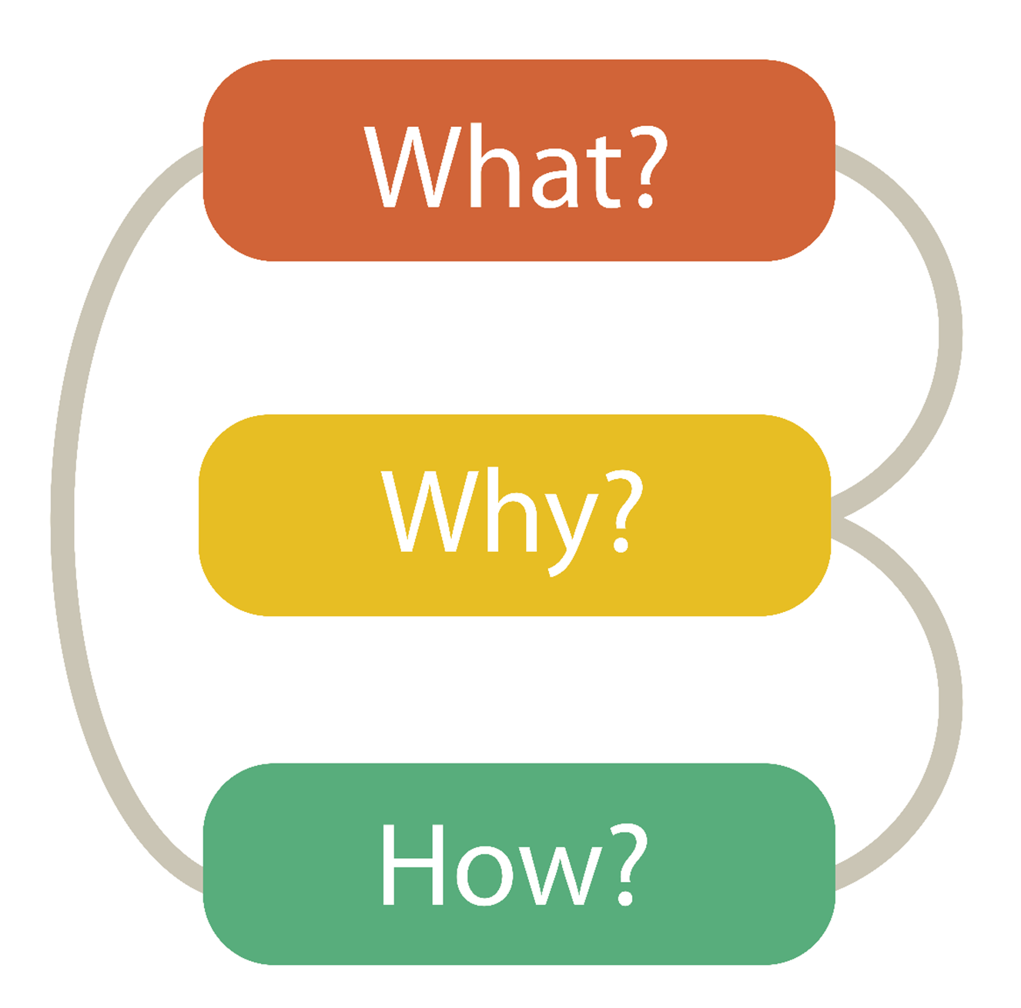

Visualization Building Blocks
Data Abstraction
Task Abstraction
Visual Encoding
Notes:
Munzner’s nested model, what why and how

Slide 11
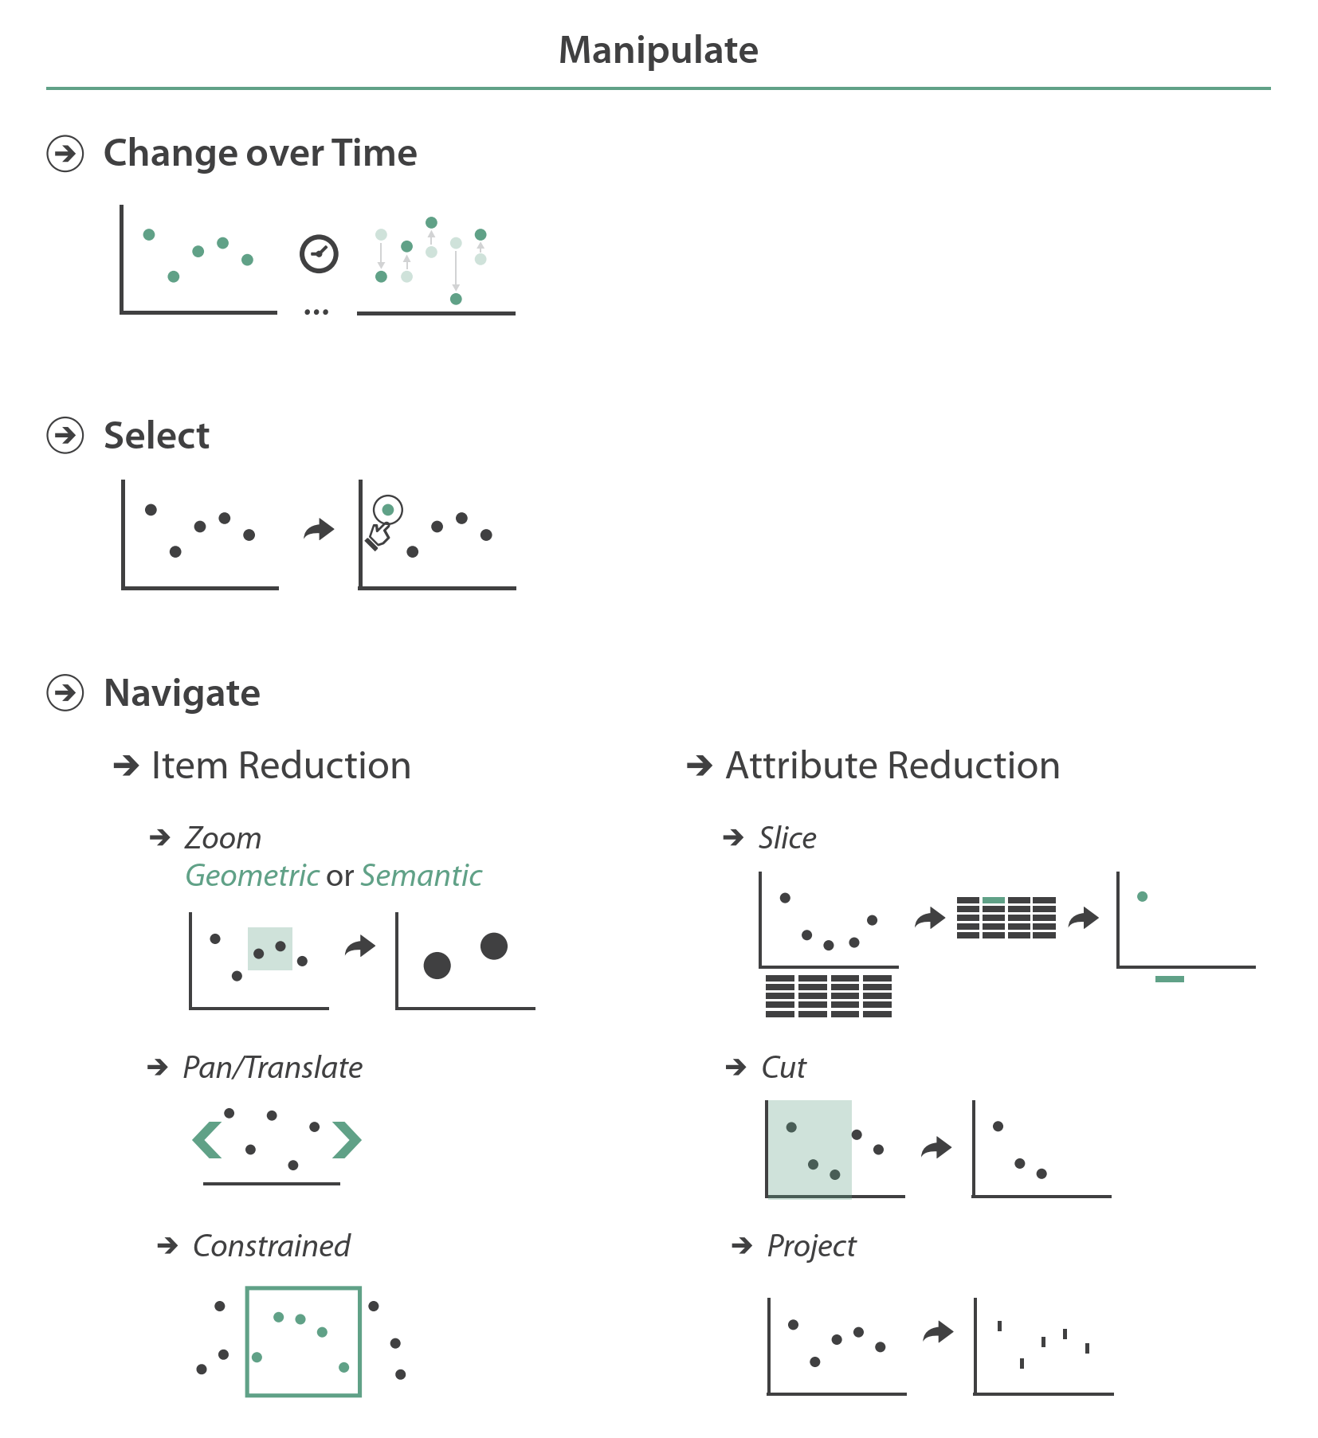
Interaction Taxonomies: Munzner
From Munzner’s book
Notes:
Now that we’ve looked at why one might or might not implement interaction, let’s look more in depth at how we define interaction for visualization.
In previous lectures, we talked about the visualization design process which is a matter of determining what you’re going to visualize, why you’re going to visualize it, and how you’re going to visualize it.
Determining what interactions to add to your visualizations is part of deciding “how” to visualize.
In Tamara’s design pipeline, interactions come in primarily when you’re deciding how you will allow users to change or manipulate a visualization.

Slide 12
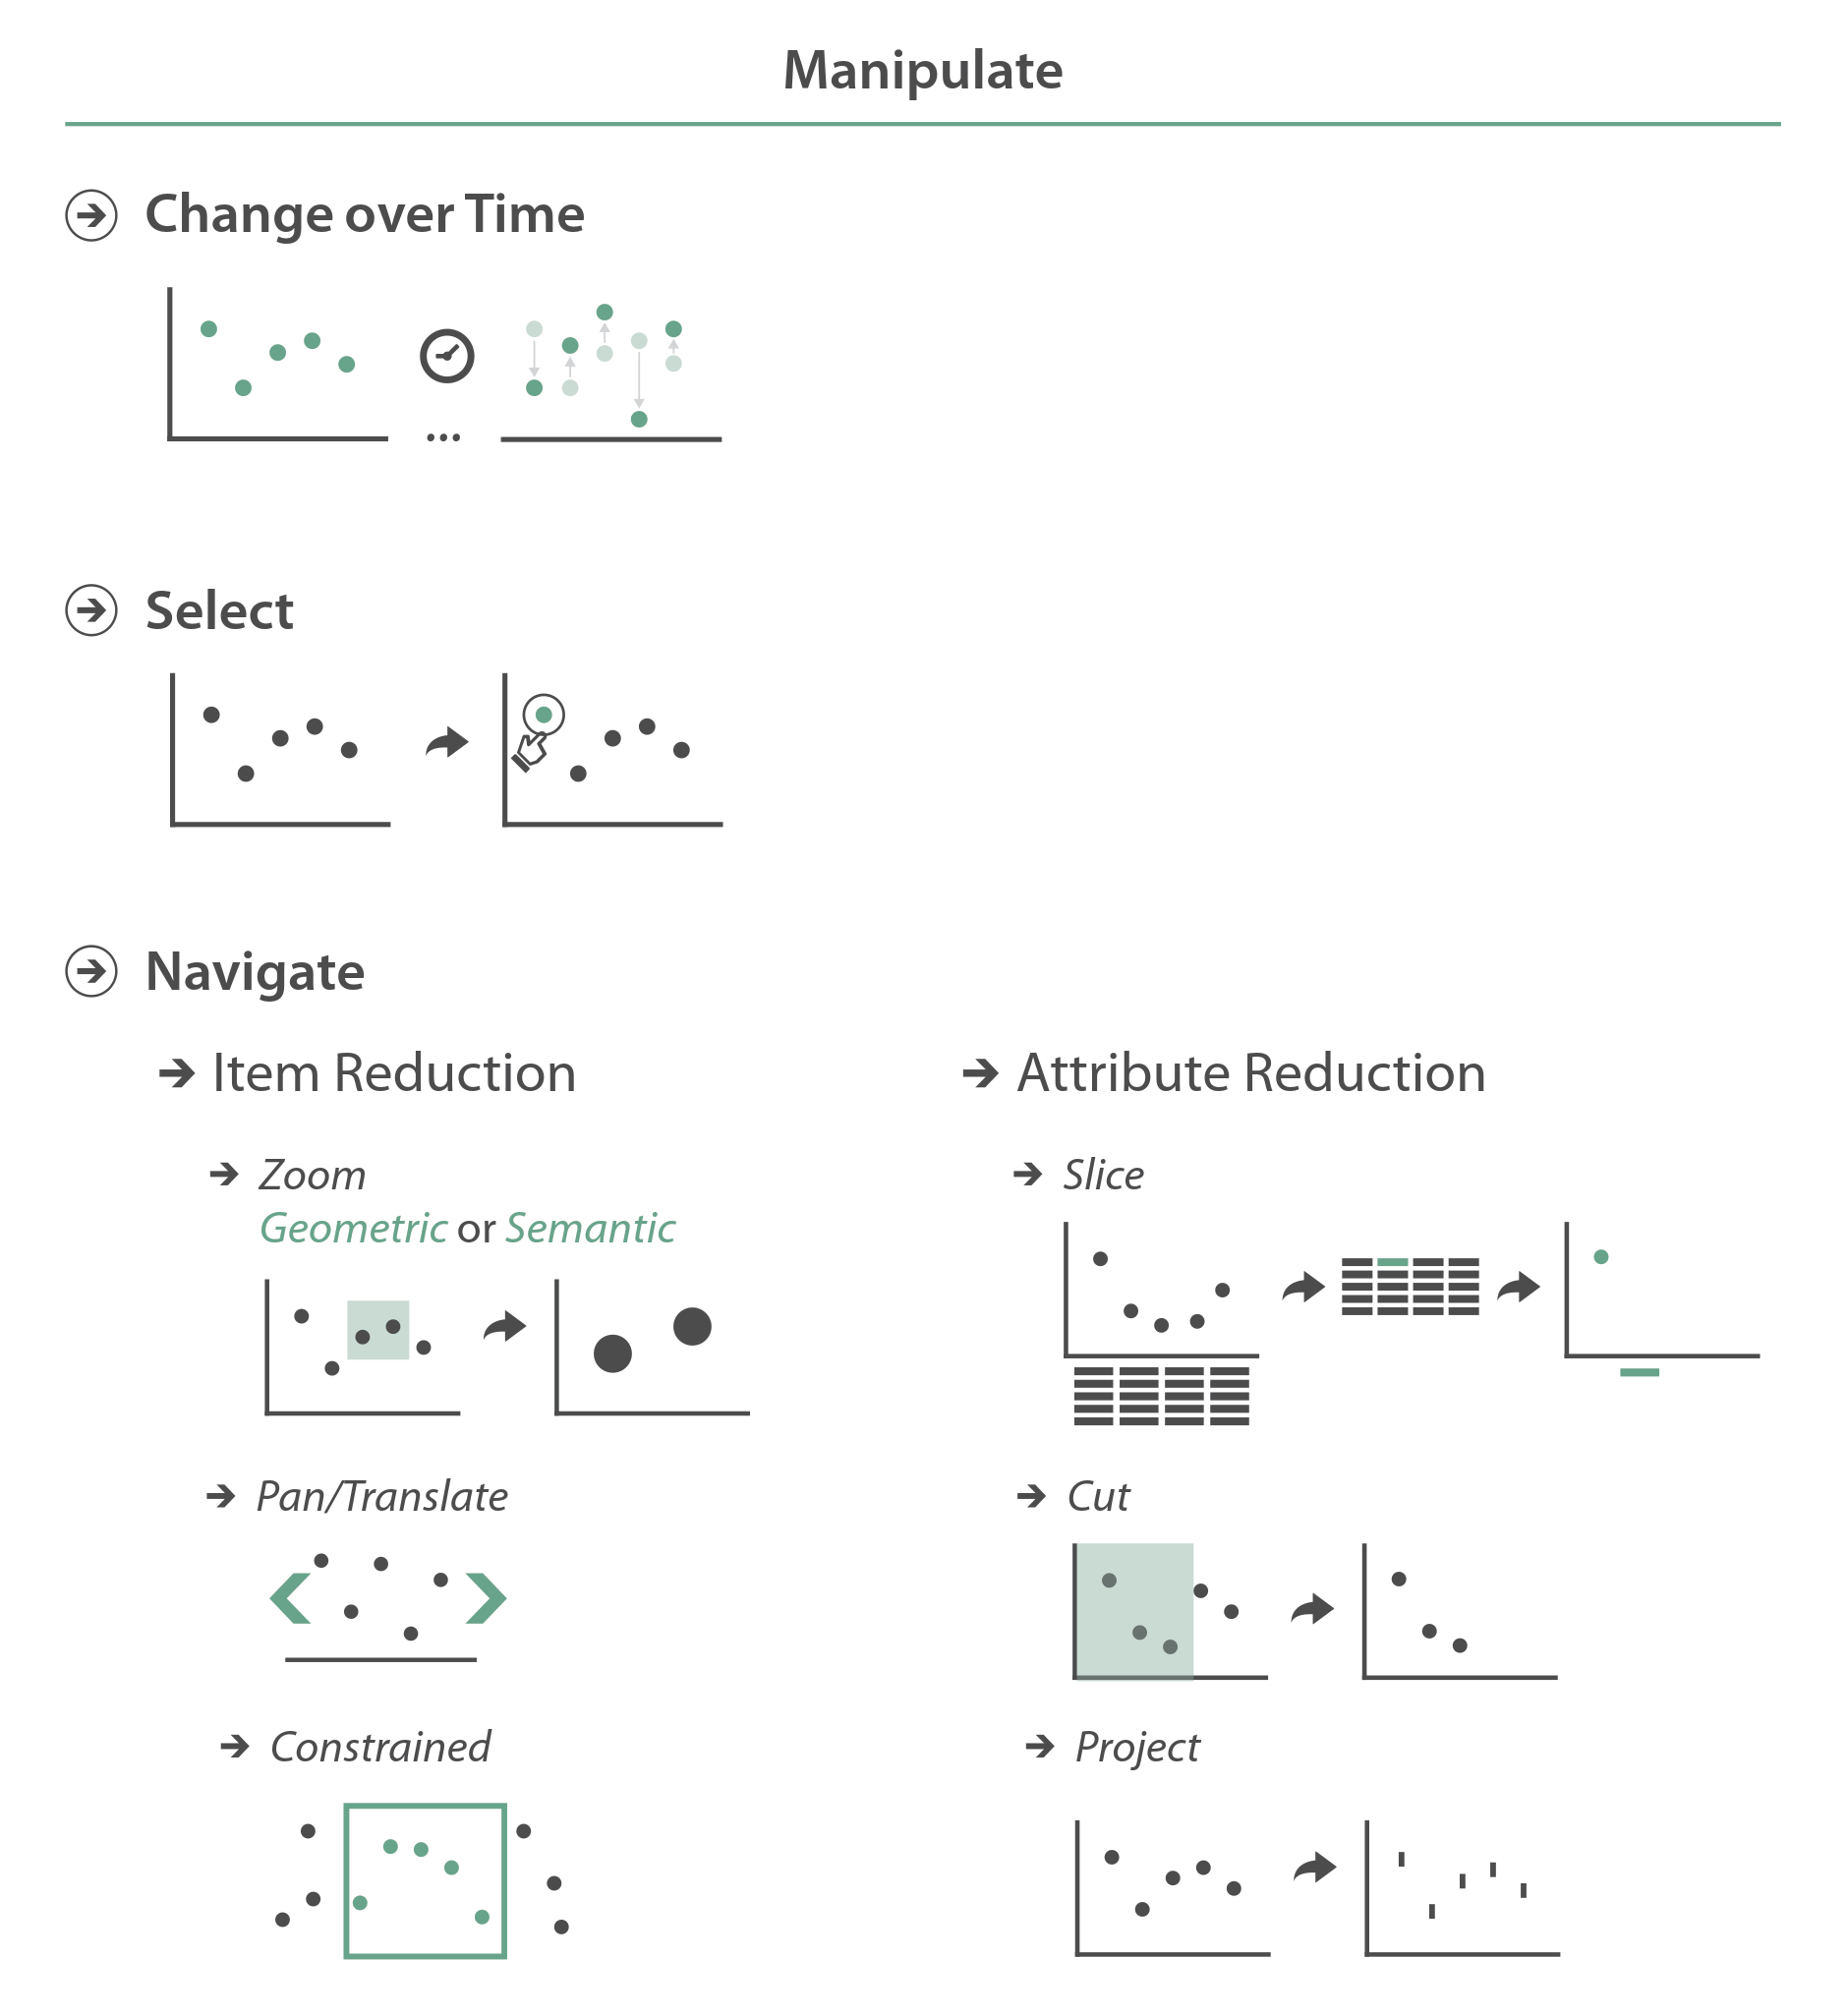

Interaction Taxonomies: Munzner
Change over time
Example: D3 Animated Transitions
http://mbostock.github.io/d3/talk/20111116/#11
Notes:
The first manipulate interaction is change over time.
This refers to allowing the user to change the visualization view.
Or in other words, allowing the user to change any of the design decisions you make during the “how” step of the design process.
For example, changing encoding, arrangement, ordering, aggregation, etc.
Animated transitions are a really common way of making these changes appear smooth.
The example here shows how the view of one visualization can be changed in multiple ways through animation.

Slide 13
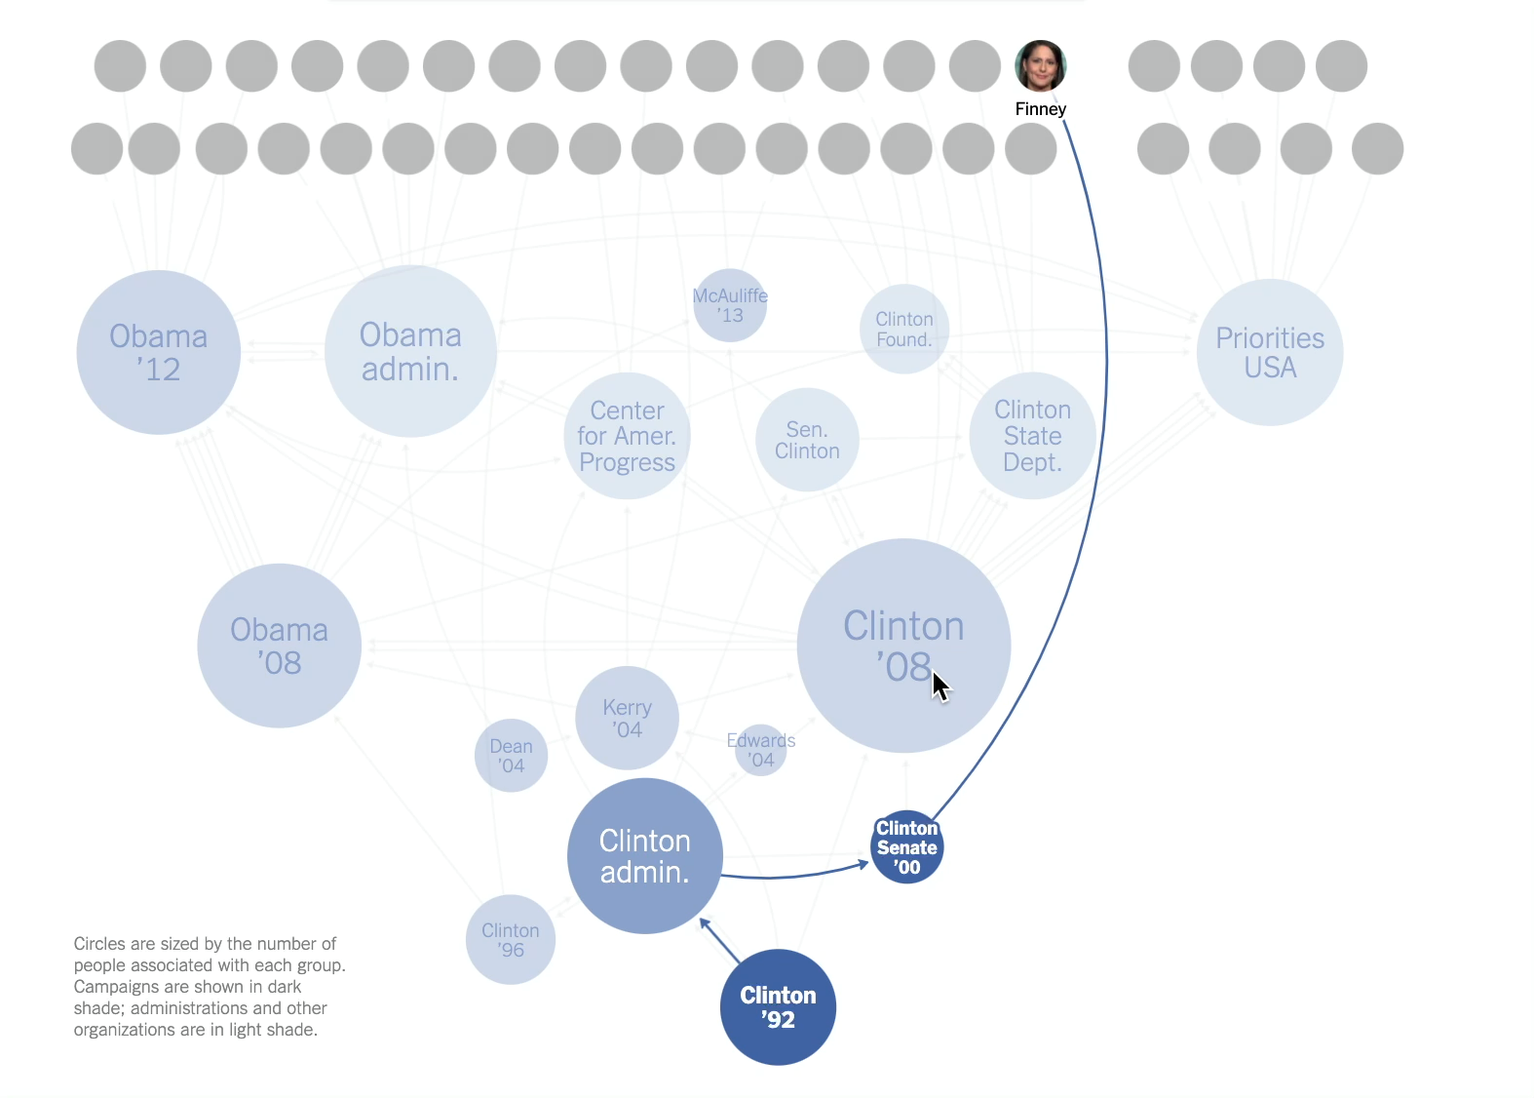
Interaction Taxonomies: Munzner
Selection
Example: NYT Campaign Connections
http://www.nytimes.com/interactive/2015/05/17/us/elections/2016-presidential-campaigns-staff-connections-clinton-bush-cruz-paul-rubio-walker.html
Notes:
The second type of manipulate interaction is selection, which refers to allowing the user to select one or more elements of interest in the visualization.
Typically, the output of select is used as the input to some other action.
For example, selecting an element can result in that element being changed, or highlighted.
In the example shown here, select is done through a mouse click on one node or data item, and as a result all items related to the selected one are highlighted.

Slide 14
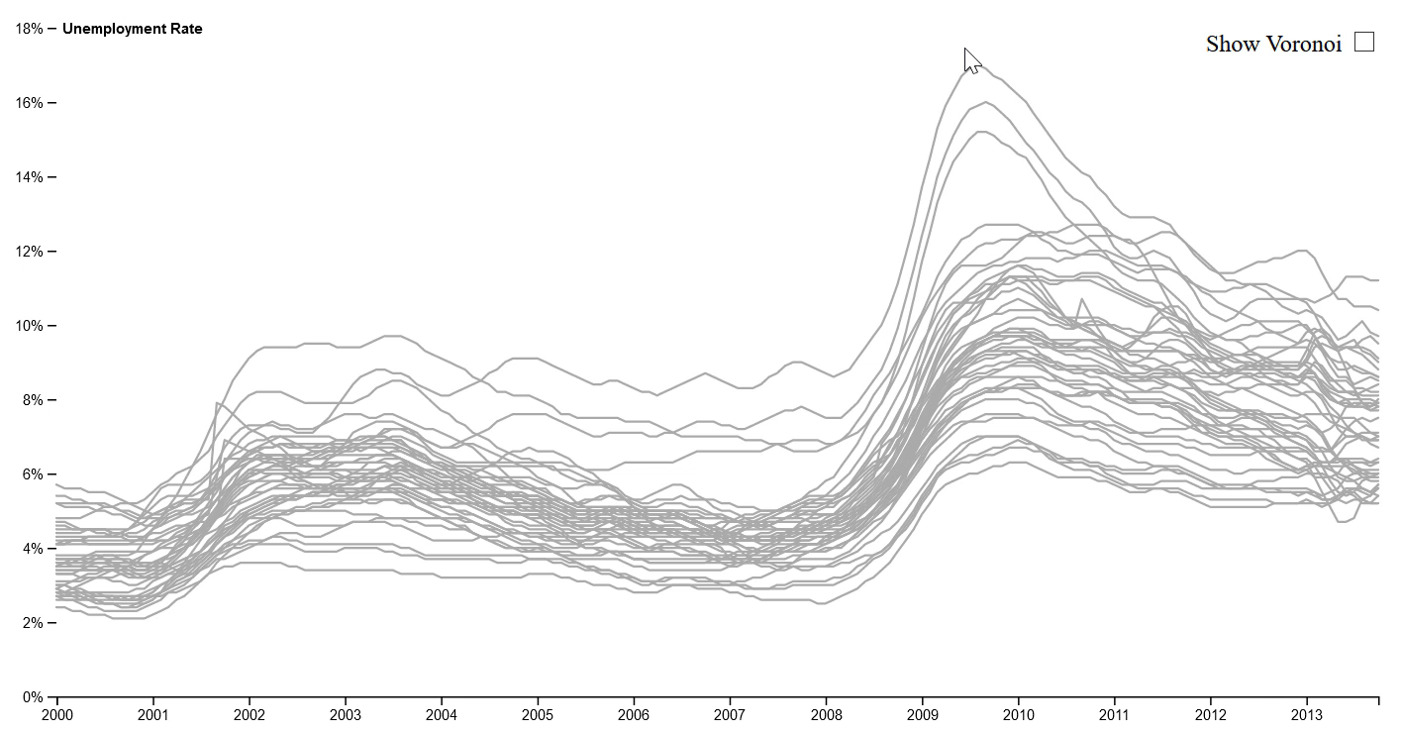
Interaction Taxonomies: Munzner
Selection
Example: Voronoi Cursors
https://bl.ocks.org/mbostock/8033015
Notes:
Another example of the select interaction are Voronoi cursors, which are cursors which automatically highlight the closest point to the mouse.
Notice in this example, only one data item is selected, which is different from the previous example where a subset of data items were selected. Deciding how many elements are or can be selected at once is part of designing an interaction idiom for your visualization.

Slide 15


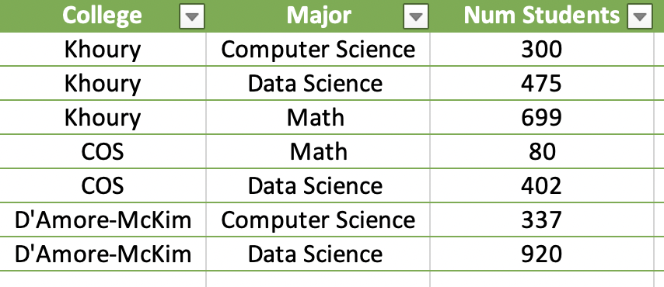
Interaction Taxonomies: Munzner
Navigate
Attributes
Items
Notes:
The third manipulate interaction is navigate, which refers to allowing the user to reduce the number of items or attributes shown on the visualization.
Multiple manipulate interactions fall within each of these categories.

Slide 16
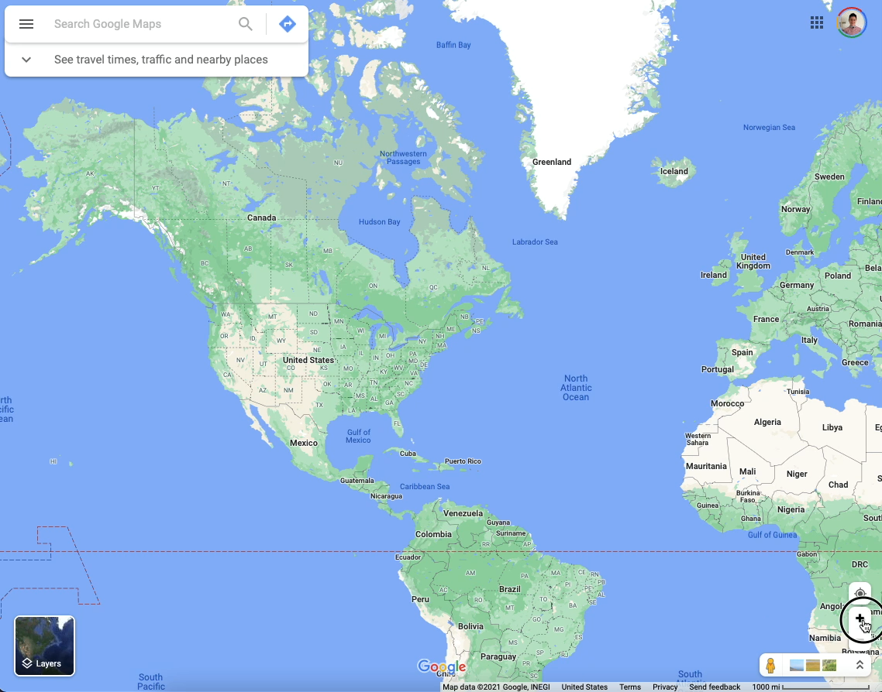
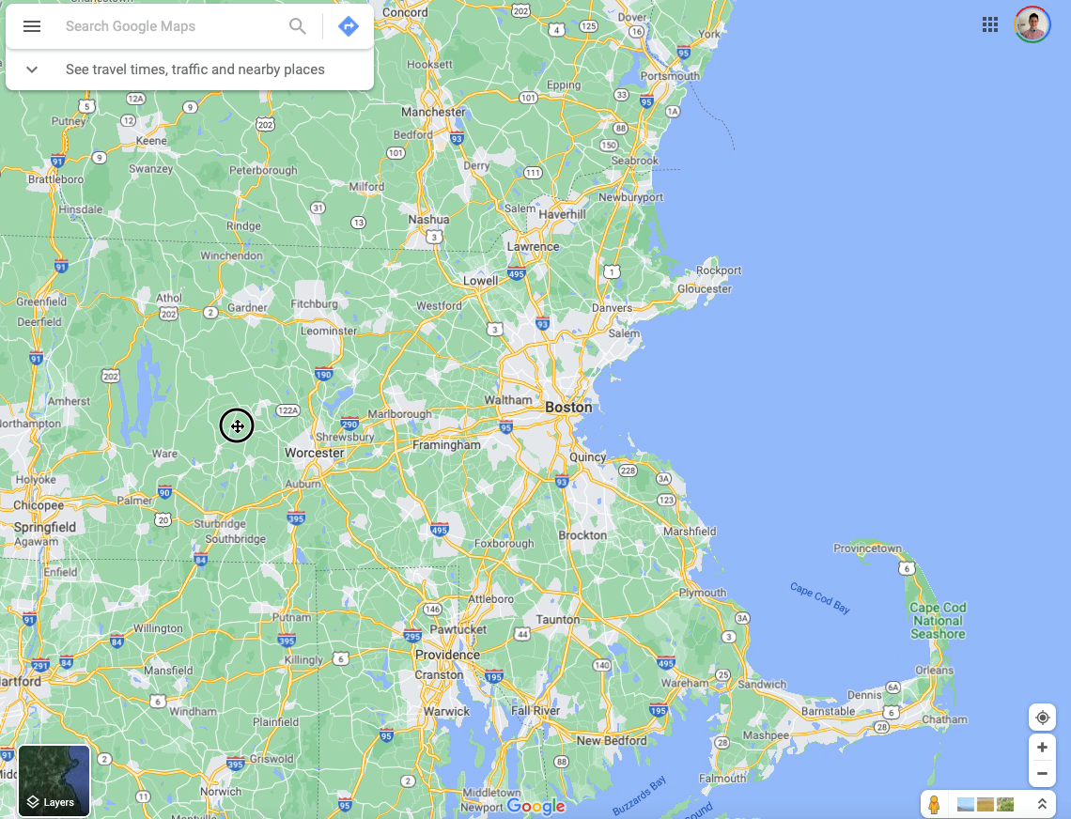
Interaction Taxonomies: Munzner
Navigate → Item reduction → Pan/Zoom
https://www.google.com/maps
Notes:
For example, item reduction can be achieved through zooming, which allows the user to move their viewpoint closer or farther from the plane of view.
Zooming can be geometric, which is mimics moving closer to an item, or semantic which is where the object changes as you zoom (for example text expanding in a document).
Google Maps in an example of a visualization with a zoom interaction.
Notice that when you’re zooming in and out on Google maps there’s a point at which you’re stopped. This is called constrained navigation, where there are bounds on where the user can navigate. Constrained navigation is common because it helps the user keep track of where they are in the visualization.

Slide 17
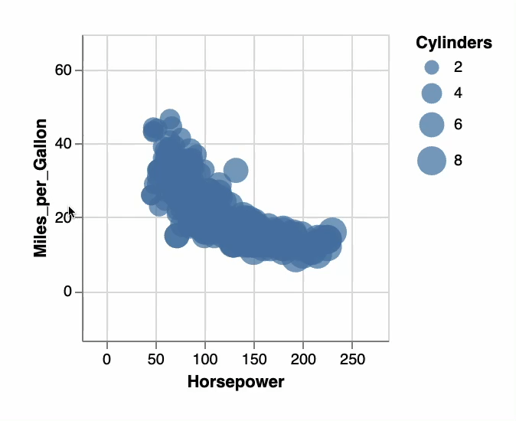
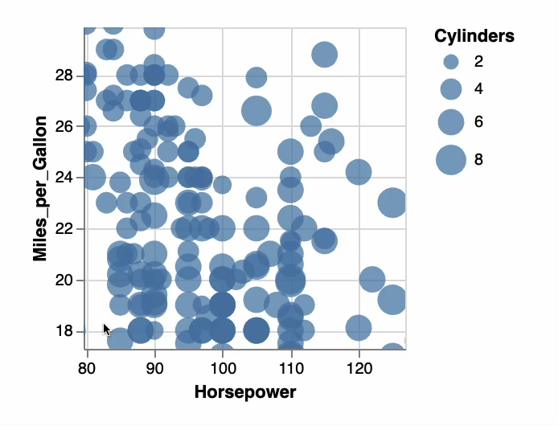
Interaction Taxonomies: Munzner
Navigate → Item reduction → Pan/Zoom
https://vega.github.io/vega-lite/examples/selection_translate_scatterplot_drag.html
Notes:
For example, item reduction can be achieved through zooming, which allows the user to move their viewpoint closer or farther from the plane of view.
Zooming can be geometric, which is mimics moving closer to an item, or semantic which is where the object changes as you zoom (for example text expanding in a document).
Google Maps in an example of a visualization with a zoom interaction.
Notice that when you’re zooming in and out on Google maps there’s a point at which you’re stopped. This is called constrained navigation, where there are bounds on where the user can navigate. Constrained navigation is common because it helps the user keep track of where they are in the visualization.

Slide 18

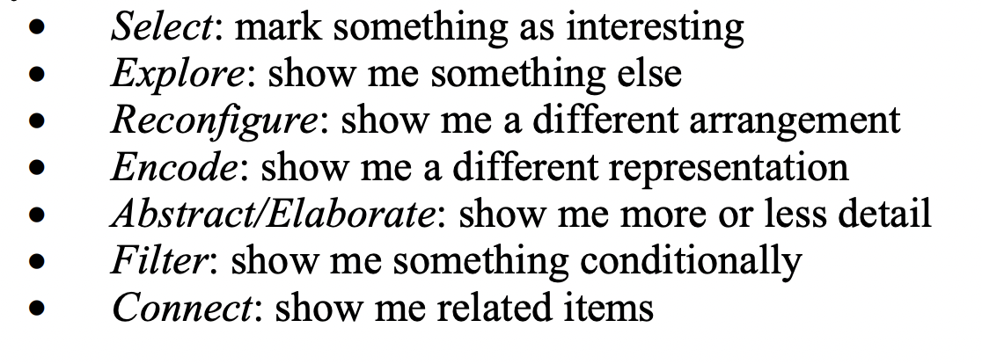
Interaction Taxonomies: Yi et al.
Notes:
For example, this is another popular interactions taxonomy, that names 7 different interactions.
<read>
<next>

Slide 19
Interaction Taxonomies: Yi et al.
http://mbostock.github.io/d3/talk/20111116/#11
Notes:
For example, this is another popular interactions taxonomy, that names 7 different interactions.
<read>
<next>

Slide 20
Interaction Taxonomies: Yi et al.
http://mbostock.github.io/d3/talk/20111116/#11
Notes:
For example, this is another popular interactions taxonomy, that names 7 different interactions.
<read>
<next>

Slide 21
Interaction Taxonomies: Yi et al.
http://www.nytimes.com/interactive/2015/05/17/us/elections/2016-presidential-campaigns-staff-connections-clinton-bush-cruz-paul-rubio-walker.html
Notes:
For example, this is another popular interactions taxonomy, that names 7 different interactions.
<read>
<next>

Slide 22
Interaction Taxonomies: Yi et al.
http://www.nytimes.com/interactive/2015/05/17/us/elections/2016-presidential-campaigns-staff-connections-clinton-bush-cruz-paul-rubio-walker.html
Notes:
For example, this is another popular interactions taxonomy, that names 7 different interactions.
<read>
<next>

Slide 23
Interaction Taxonomies: Yi et al.
https://bl.ocks.org/mbostock/8033015
Notes:
For example, this is another popular interactions taxonomy, that names 7 different interactions.
<read>
<next>

Slide 24
Interaction Taxonomies: Yi et al.
https://bl.ocks.org/mbostock/8033015
Notes:
For example, this is another popular interactions taxonomy, that names 7 different interactions.
<read>
<next>

Slide 25
Interaction Taxonomies: Yi et al.
https://vega.github.io/vega-lite/examples/selection_translate_scatterplot_drag.html
Notes:
For example, this is another popular interactions taxonomy, that names 7 different interactions.
<read>
<next>

Slide 26
Interaction Taxonomies: Yi et al.
https://vega.github.io/vega-lite/examples/selection_translate_scatterplot_drag.html
Notes:
For example, this is another popular interactions taxonomy, that names 7 different interactions.
<read>
<next>

Slide 27
Interaction Taxonomies: Yi et al.
https://vega.github.io/vega-lite/examples/selection_translate_scatterplot_drag.html
Notes:
For example, this is another popular interactions taxonomy, that names 7 different interactions.
<read>
<next>

Slide 28
Interaction Taxonomies: Yi et al.
https://vega.github.io/vega-lite/examples/selection_translate_scatterplot_drag.html
Notes:
For example, this is another popular interactions taxonomy, that names 7 different interactions.
<read>
<next>

Slide 29
Interaction Taxonomies: Yi et al.
Notes:
For example, this is another popular interactions taxonomy, that names 7 different interactions.
<read>
<next>

Slide 30
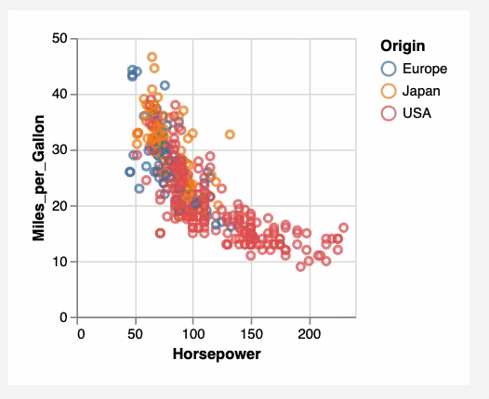
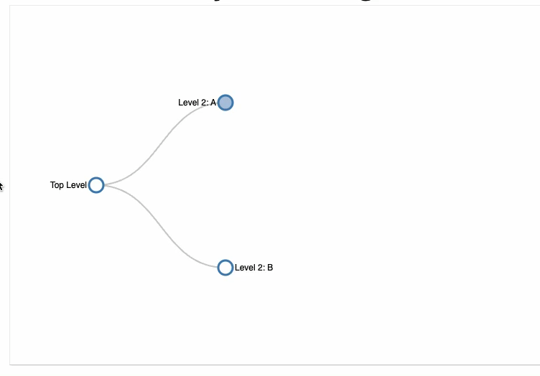
Interaction Taxonomies: Yi et al.
https://vega.github.io/editor/#/examples/vega-lite/point_href
https://bl.ocks.org/d3noob/8375092
Notes:
For example, this is another popular interactions taxonomy, that names 7 different interactions.
<read>
<next>

Slide 31
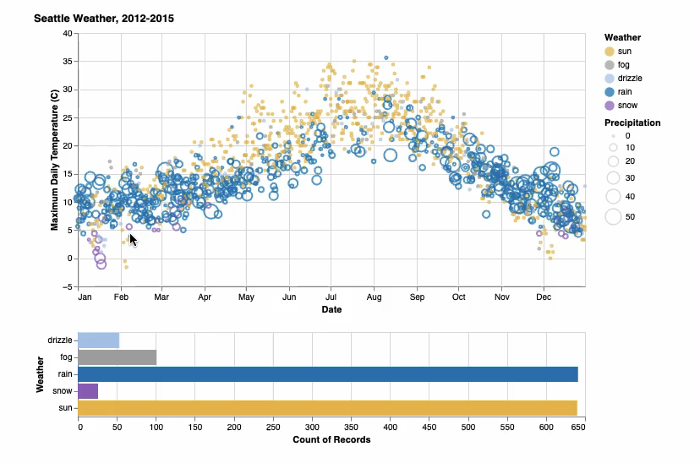
Interaction Taxonomies: Yi et al.
https://vega.github.io/vega-lite/examples/interactive_seattle_weather.html
Notes:
For example, this is another popular interactions taxonomy, that names 7 different interactions.
<read>
<next>

